Slide 1







Customer Data Management and Analysis

Slide 2

Project Overview
Objective:
This project aims to develop a machine learning application that leverages Kaggle datasets to predict outcomes using various machine learning models. The application will utilize SQL Server for data storage and processing, Power BI for data visualization and analysis, and Flask for web application development.
Approach:
Data Acquisition: Gather and prepare relevant data from Kaggle.
Data Storage: Store the cleaned data in a SQL Server database.
Data warehousing:Create data warehouse in SQL server.
ETL process: Extract data from traditional database ,applying transformations to it and loading in datawarehouse.
Model Development: Select and train appropriate machine learning algorithms.
Prediction and Visualization: Use the trained model to make predictions.
Power BI : visualize the results using Power BI.
Deployment: Deploy the web application to a suitable environment.

Slide 3
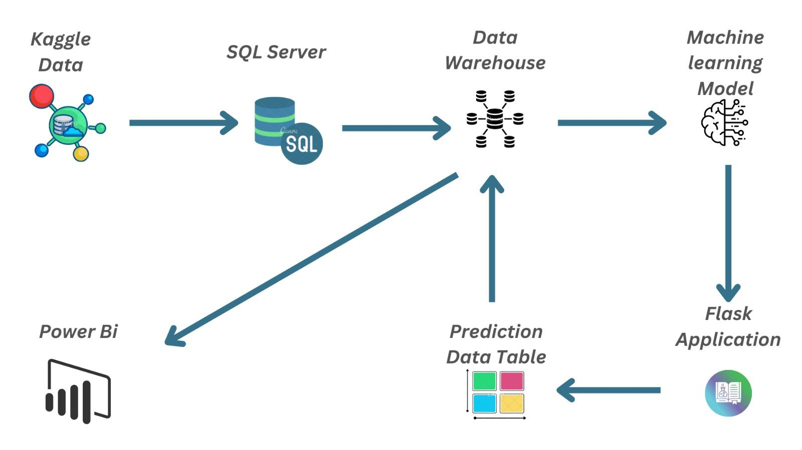
data architecture diagram

Slide 4
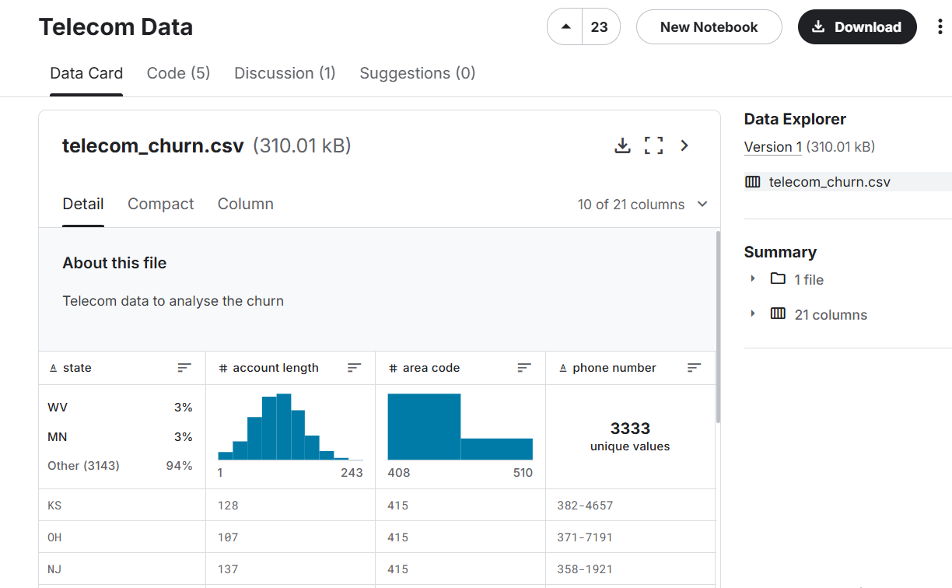
Telecom Data

Slide 5

The contnents
The dataset contains detailed information about 7,043 telecom customers, covering various aspects of their demographics, service usage, and billing.
Demographics: Gender, senior citizen status, partner, dependents.
Services: Phone, internet, security, backup, streaming, tech support.
Billing: Monthly charges, total charges, payment method.
Churn: Indicates if the customer has left the service.

Slide 6

Data understanding
The telecom company manages its operations by linking customer data, service plans, and city demographics. Customers are associated with specific cities, which store details like population, internet coverage, and income. The company offers internet plans with options like security and streaming services, and tracks each customer's charges, contract information, and payment preferences. This structure allows the company to analyze customer behavior, service usage, and churn, helping to make data-driven decisions for improving services and customer retention.

Slide 7
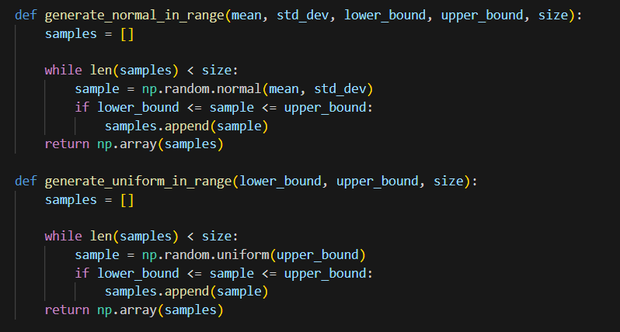
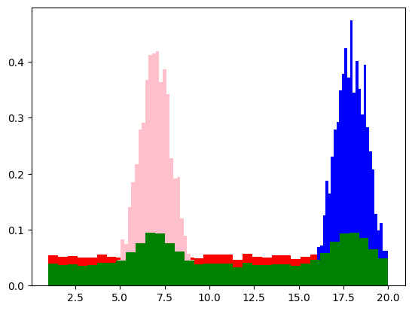
DATA EXPANSION
cities

Slide 8
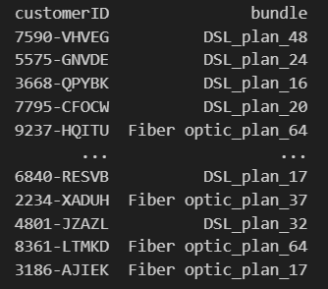
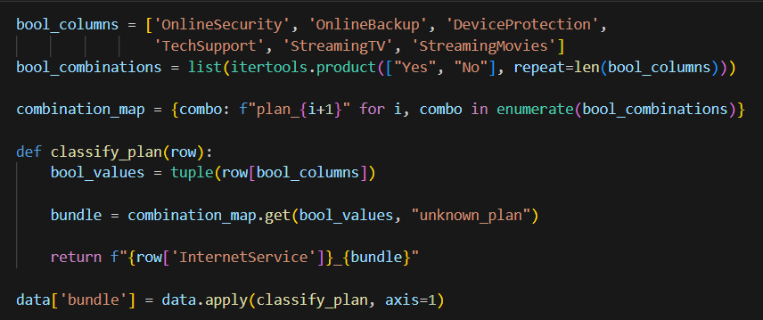
DATA EXPANSION
plans

Slide 9
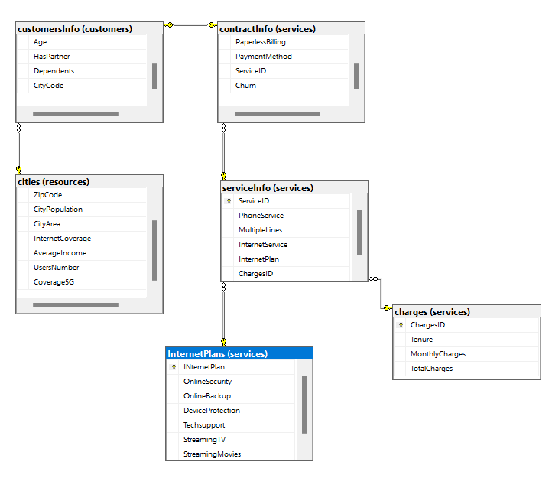
Customer Feedback Database Schema
The database is organized into three schemas: customers, services, and resources.
Resources Schema:
Contains the cities table, storing city details like population, area, and 5G coverage.
Customers Schema:
Contains the customersInfo table, with customer data like age, gender, and city (linked to cities).
Services Schema:
Includes tables for internet plans, charges, and service details.
The contractInfo table links customers to their services and tracks contracts, payments, and churn.

Slide 10

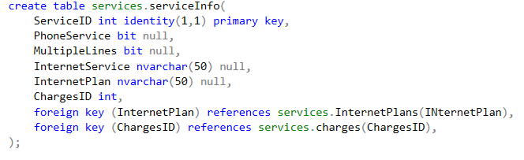
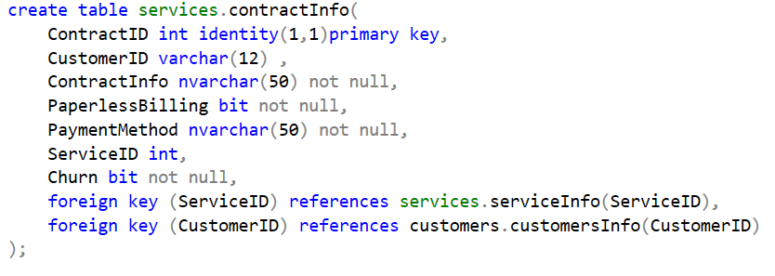
A PEEK ON THE CODE
Tables creation:

Slide 11
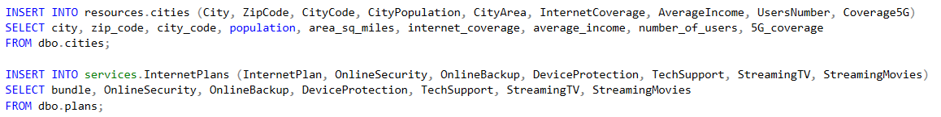
A PEEK ON THE CODE
Data insertion:

Slide 12
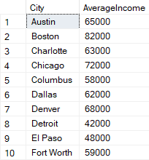
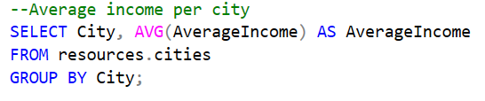
A PEEK ON THE CODE
Output :
Basic data queries:

Slide 13
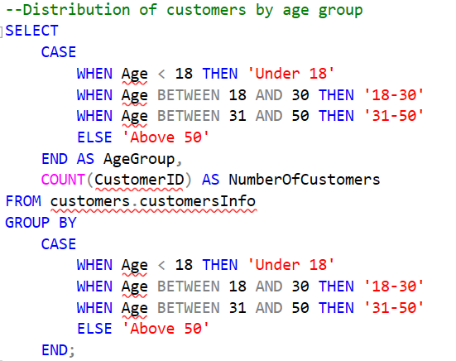
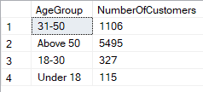
A PEEK ON THE CODE
Output:

Slide 14
Overview of the Data Warehouse (DWH) Structure
The Data Warehouse is designed to store historical and analytical data for evaluating customer behavior, service usage, and related metrics. It consists of the following tables:
Dimension Tables:
dimCustomer: Contains detailed customer information.
Columns: CustomerID (PK), Gender, Age, HasPartner, Dependents, CityCode (FK).
Index: Clustered index on CustomerID for quick lookups.
dimCity: Contains information about cities where customers are located.
Columns: CityCode (PK), City, ZipCode, CityPopulation, CityArea, InternetCoverage, AverageIncome, UsersNumber, Coverage5G.
Index: Clustered index on CityCode.
dimInternetPlan: Contains details of various internet plans.
Columns: InternetPlan (PK), OnlineSecurity, OnlineBackup, DeviceProtection, TechSupport, StreamingTV, StreamingMovies.
Index: Clustered index on InternetPlan.
dimService: Contains service-related data for each customer.
Columns: ServiceID (PK), PhoneService, MultipleLines, InternetService, InternetPlan (FK).

Slide 15
Overview of the Data Warehouse (DWH) Structure
Fact Table:
factCharges: Contains transactional data for charges, linked to dimensions.
Columns: ChargesID (PK), CustomerID (FK), CityCode (FK), ServiceID (FK), InternetPlan (FK), Tenure, MonthlyCharges, TotalCharges, ContractInfo, PaperlessBilling, PaymentMethod, Churn.
Indexes applied:
Clustered index on ChargesID for identifying each charge entry.
Non-clustered indexes on CustomerID, CityCode, and ServiceID to improve join performance during queries.
Relationships between Fact and Dimension Tables:
Fact table (factCharges) is linked to the dimensions dimCustomer, dimCity, dimService, and dimInternetPlan through foreign keys to enable analysis and aggregation across different perspectives, such as by city, customer demographics, and service plans.

Slide 16
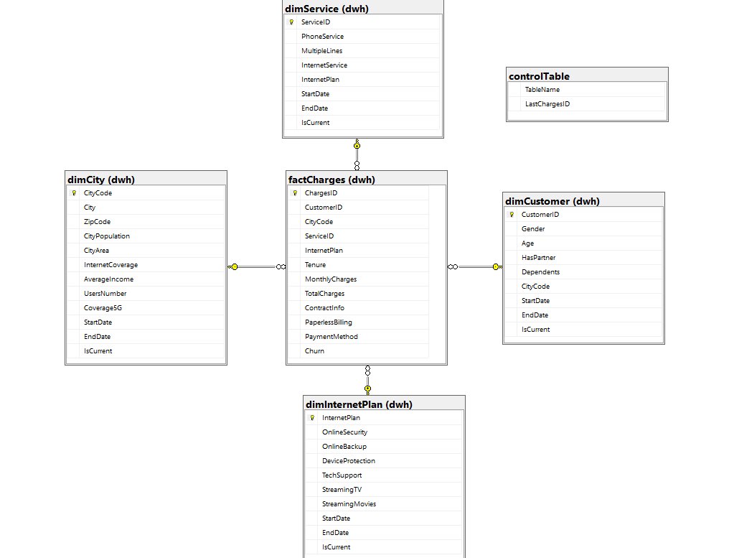
Overview of the Data Warehouse (DWH) Structure

Slide 17
2. ETL Process Overview
The ETL pipeline, designed using SSIS, automates the extraction, transformation, and loading of data from the source database into the Data Warehouse:
Source Data:
The source database is structured across three schemas: customers, services, and resources.
Key tables in the source database include:
services.charges (Transactional charge data)
customers.customersInfo (Customer demographic data)
resources.cities (City-related data)
services.serviceInfo (Service subscription details)
services.contractInfo (Contract information)

Slide 18
2. ETL Process Overview
Data Extraction:
SQL queries are used to extract data from the source database into SSIS.
.Data is retrieved from the fact tables (e.g., services.charges) and dimension tables (e.g., customers.customersInfo).
Data Transformation:
Data is transformed to ensure consistency with the DWH schema:
Data cleansing: Handles missing values and invalid data.
Data type conversions: Ensures compatibility between the source and destination tables.
Slowly Changing Dimension (SCD) processing is applied to dimension tables to track changes over time.

Slide 19
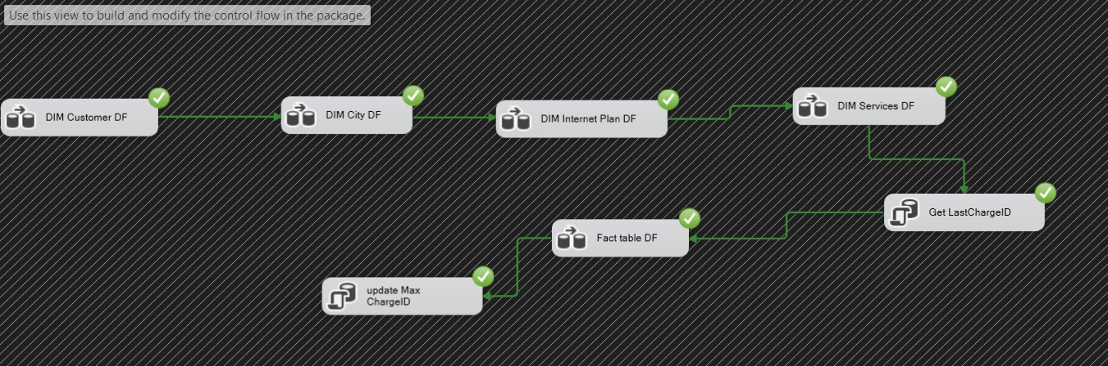
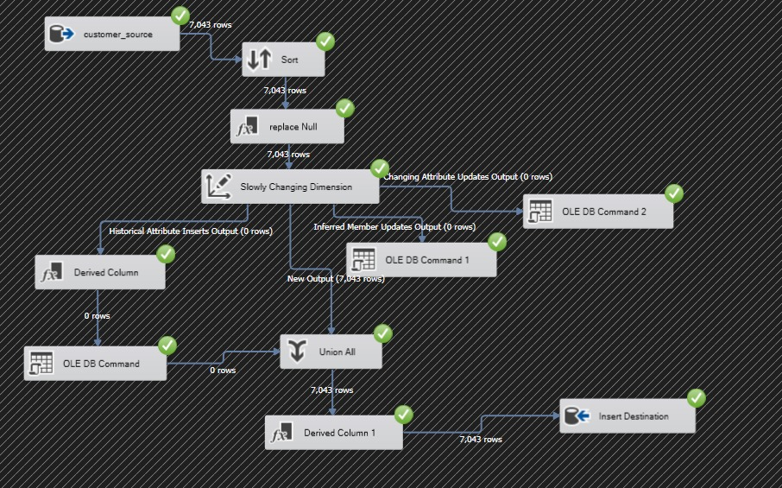
2. ETL Process Overview
Data Load:
Data is loaded incrementally into the fact and dimension tables, preserving existing data and adding new records.
Referential integrity is ensured through foreign keys between fact and dimension tables.

Slide 20
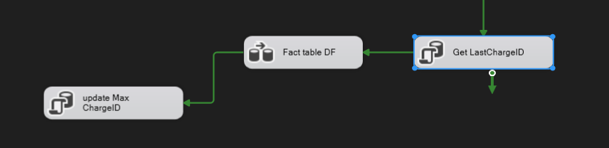
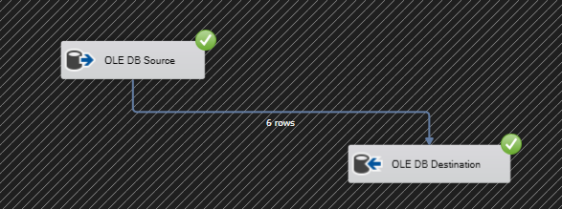
3. Incremental Load Mechanism
The incremental load process ensures that only new or changed records are loaded into the Data Warehouse, which improves performance and reduces data redundancy.
Fact Table Incremental Load:
The fact table (factCharges) uses the ChargesID as an auto-incrementing primary key.
A SQL task retrieves the maximum ChargesID currently loaded in the DWH.
A SQL query filters the source data to include only new records with ChargesID greater than the retrieved maximum.
This method ensures that only new transactions are inserted into the fact table during the ETL process.

Slide 21
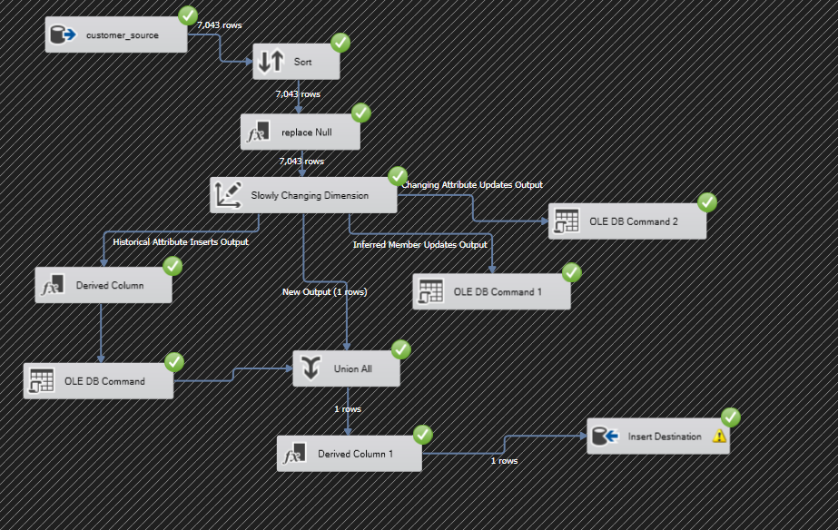
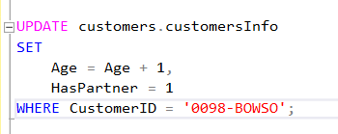
3. Incremental Load Mechanism
SCD in Dimension Tables:
SCD Type 2 is applied to dimension tables (dimCustomer, dimCity, dimService, dimInternetPlan).
Each dimension table has StartDate, EndDate, and IsCurrent columns to manage historical data:
New Records: Inserted with StartDate and IsCurrent = 1.
Updated Records: The old version of the record has its EndDate updated and IsCurrent = 0, and a new record is inserted.

Slide 22
4. Tools Used
The tools used for building and maintaining the Data Warehouse and ETL solution include:
SQL Server:
SQL Server is used to store both the source data and the Data Warehouse.
The DWH uses SQL Server relational tables, which are optimized for querying and reporting.
SSIS (SQL Server Integration Services):
SSIS is used to design and execute the ETL pipeline.
Data Flow Tasks: Extract data from source tables, apply transformations (e.g., data type conversion, SCD processing), and load the data into the DWH.
Control Flow Tasks: Manage the ETL process, ensuring that data flows in the correct order and handles errors efficiently.
SCD Transformation: Ensures dimension tables track historical data.

Slide 23

Random Forest Model for Churn Prediction
Introduction
Objective: Explore the use of machine learning in predicting customer churn using a Random Forest classifier.
Dataset split into training and testing with standardized features.

Slide 24

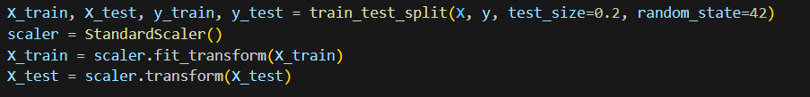
Train-Test Split and Feature Scaling
Data was split into features (X) and target (y).
80% of data used for training, 20% for testing.
Standardization applied using StandardScaler.
Key Code Snippet:

Slide 25







Model Training: Random Forest Classifier
Random Forest used as the machine learning model.
Model trained on standardized training data.
Key Code Snippet:
rf = RandomForestClassifier(random_state=42)
rf.fit(X_train, y_train)
y_pred = rf.predict(X_test)

Slide 26
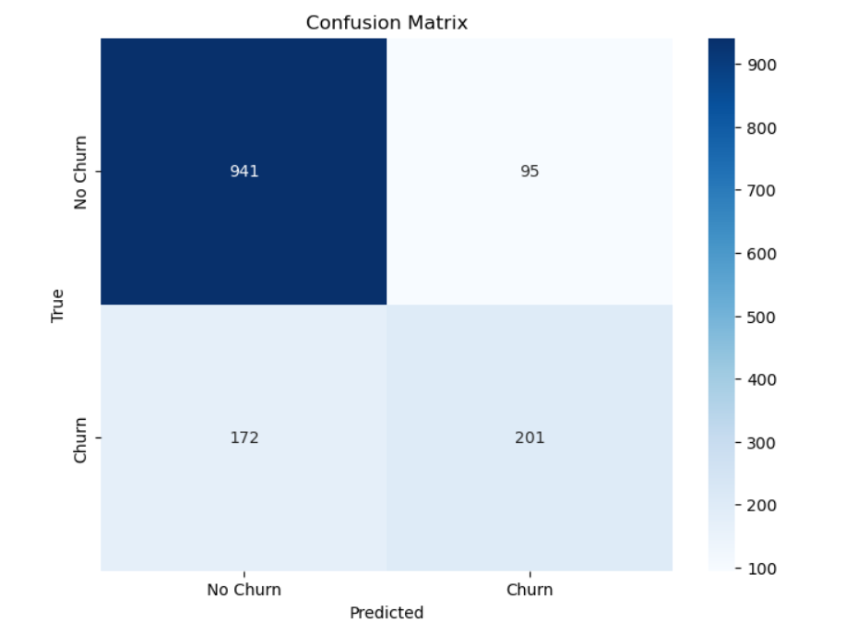
Confusion Matrix: Model Evaluation

Slide 27
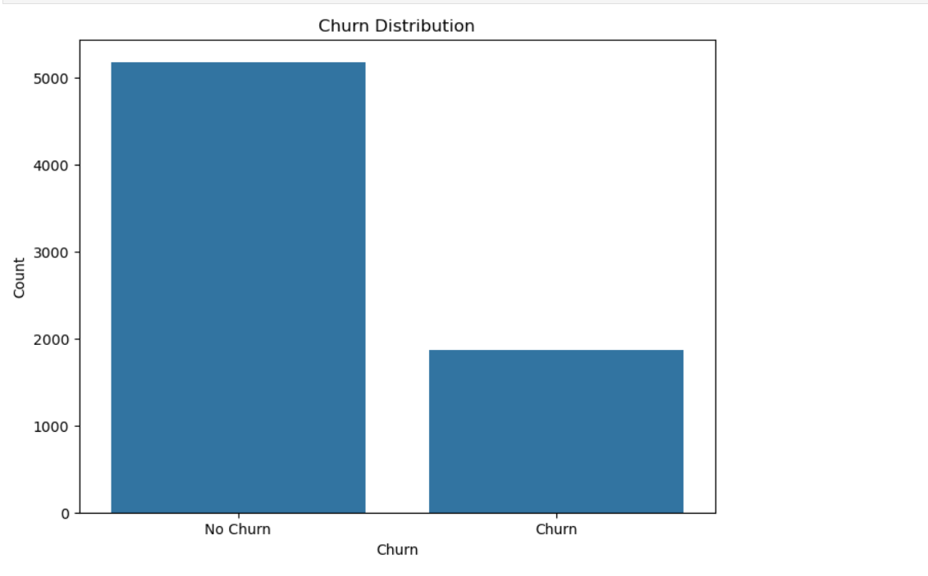
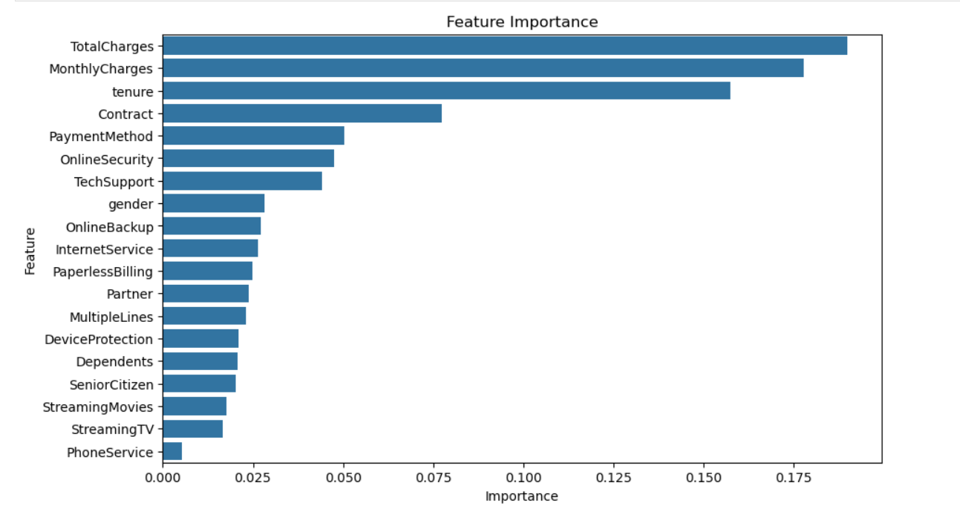
Churn distribution
Feature importance for data

Slide 28
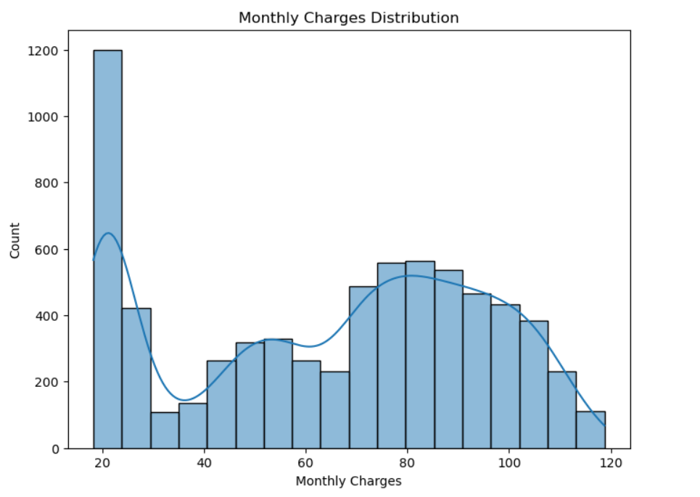
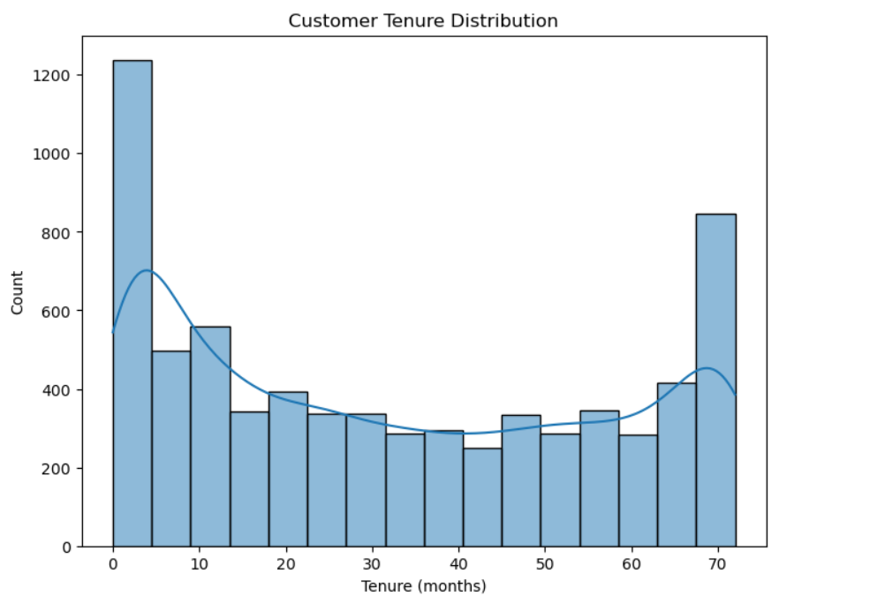
monthly distribution
Customer distribution

Slide 29
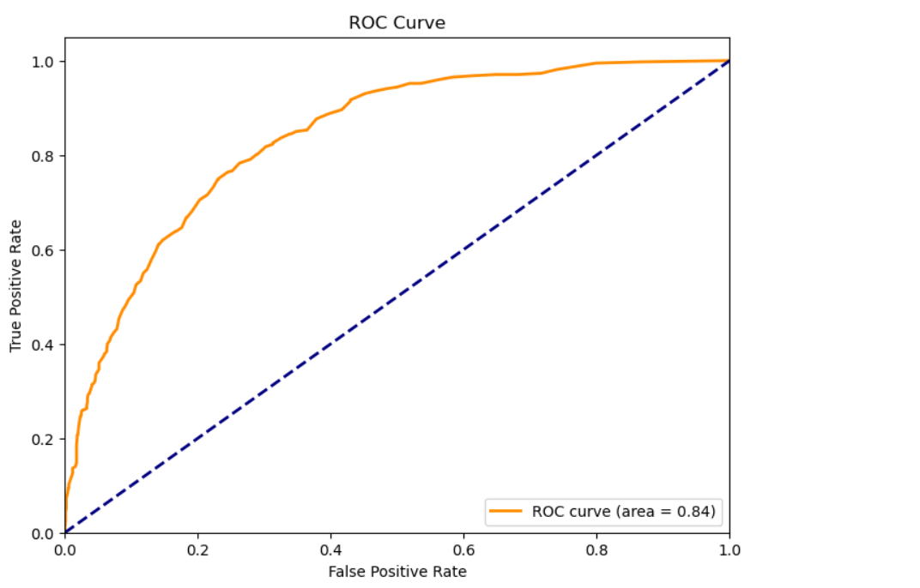
Roc curve

Slide 30
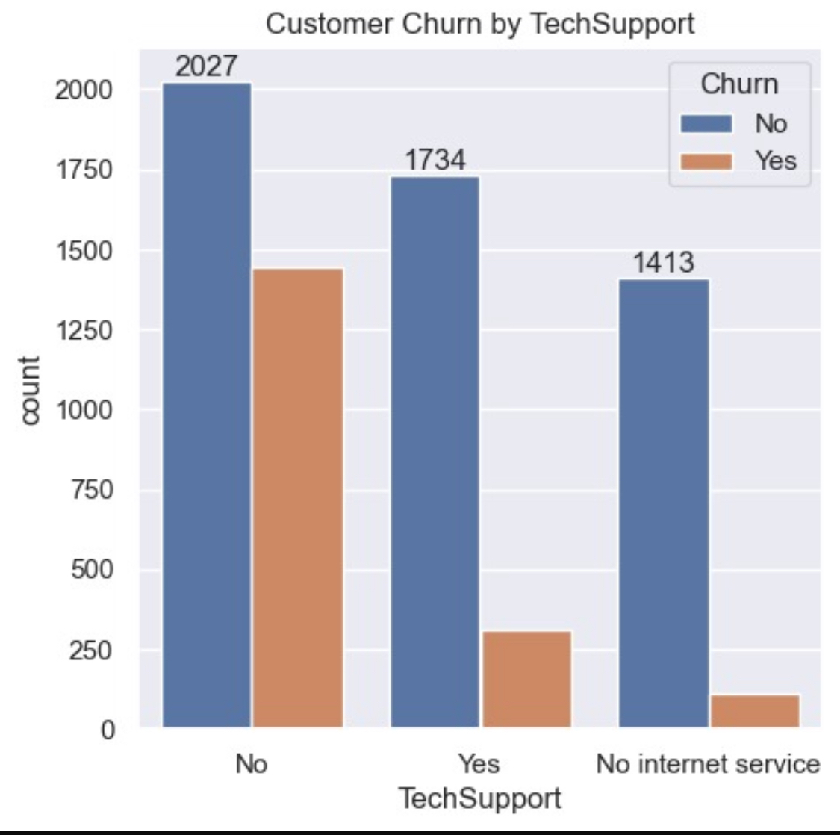
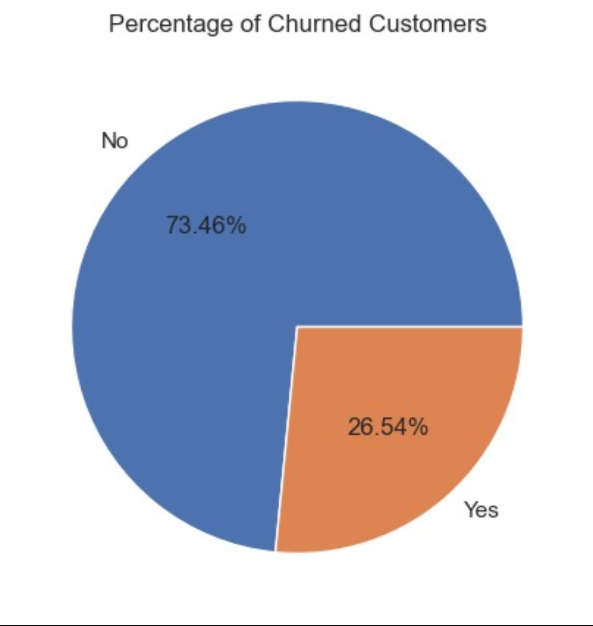
Customers churns

Slide 31
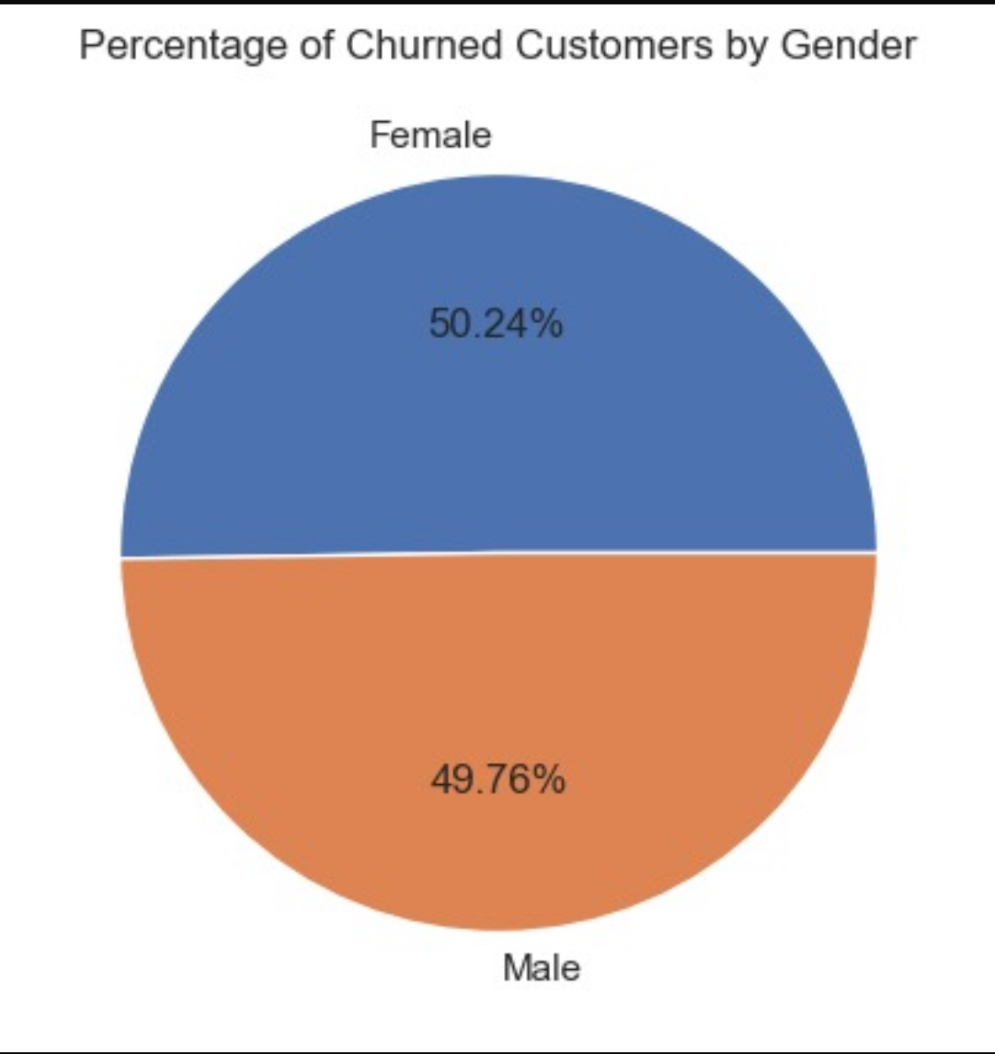
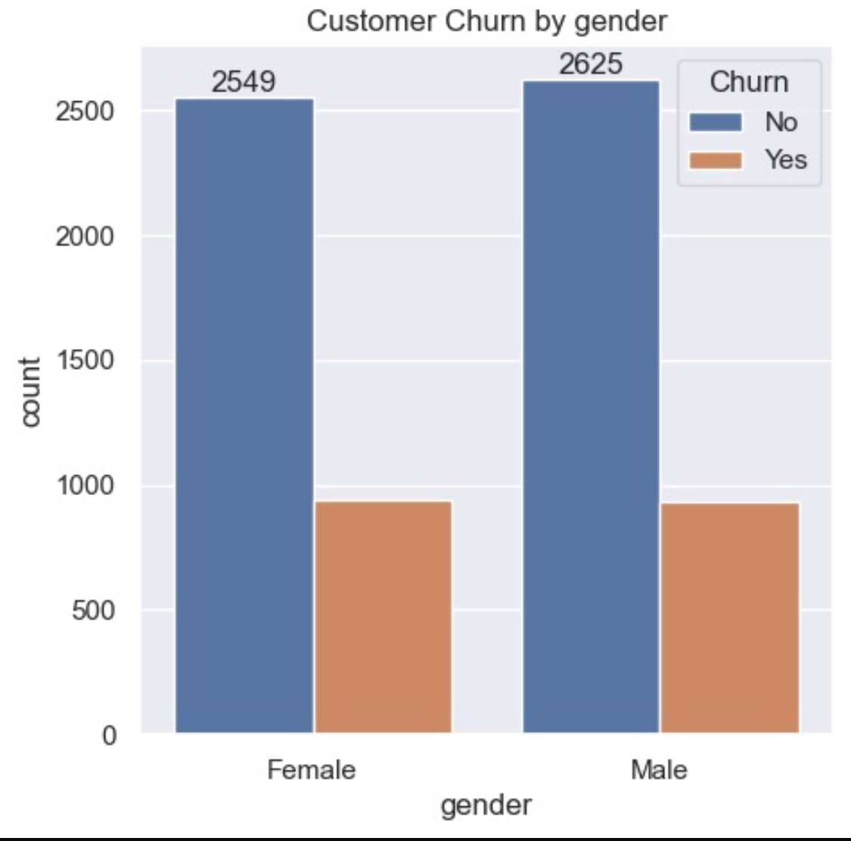
By gender

Slide 32
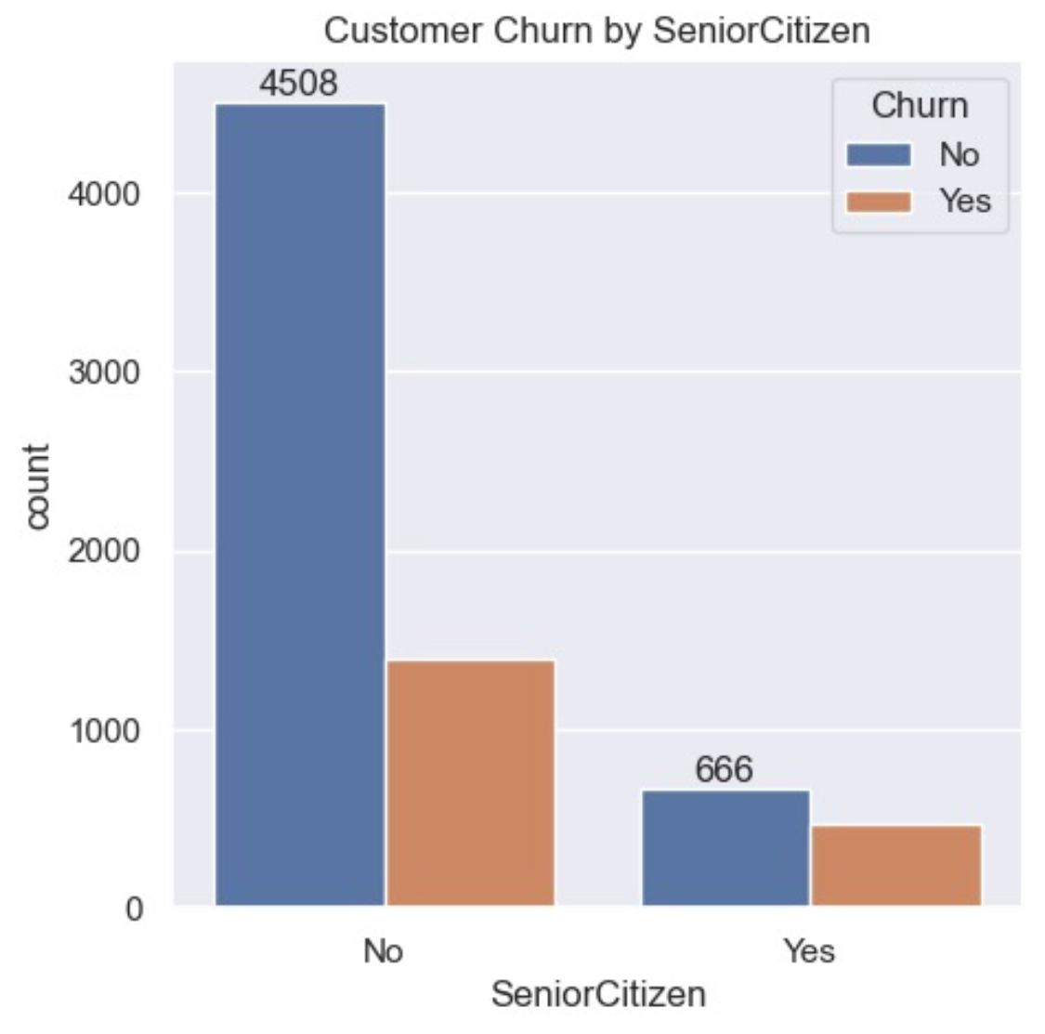
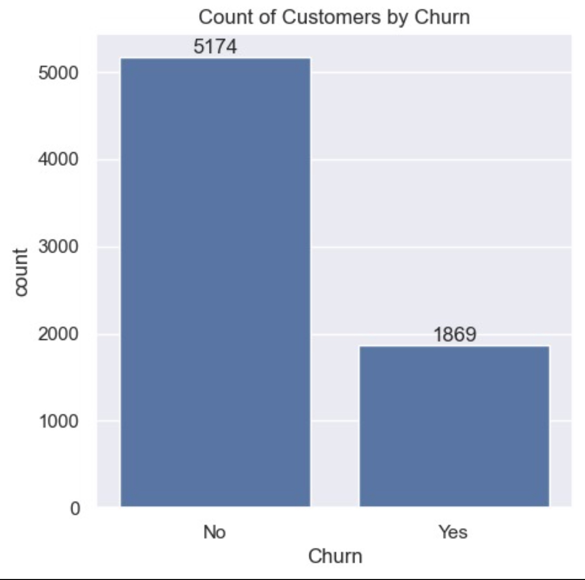
Counts

Slide 33
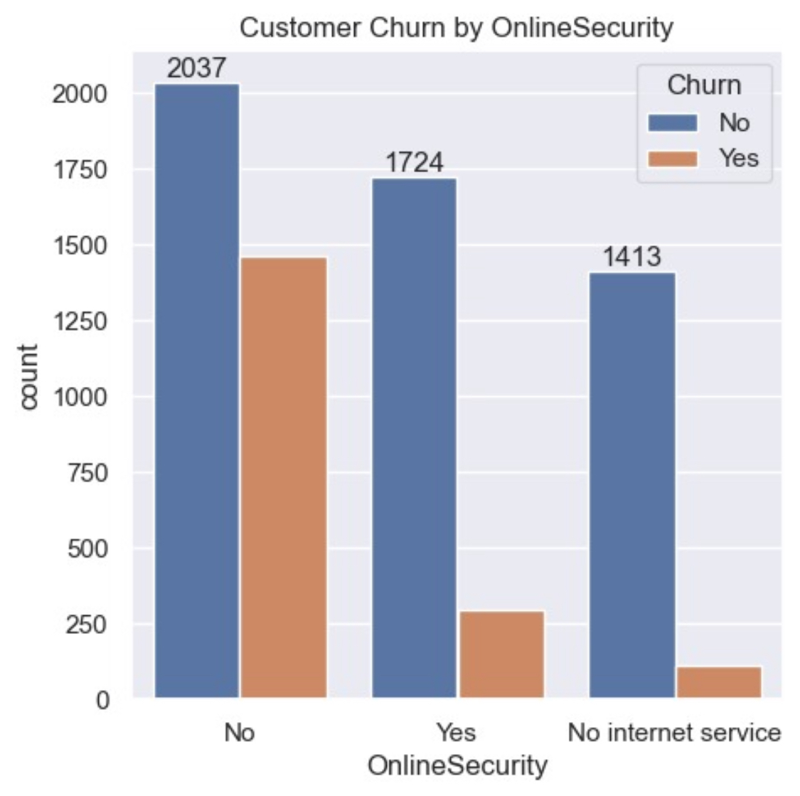
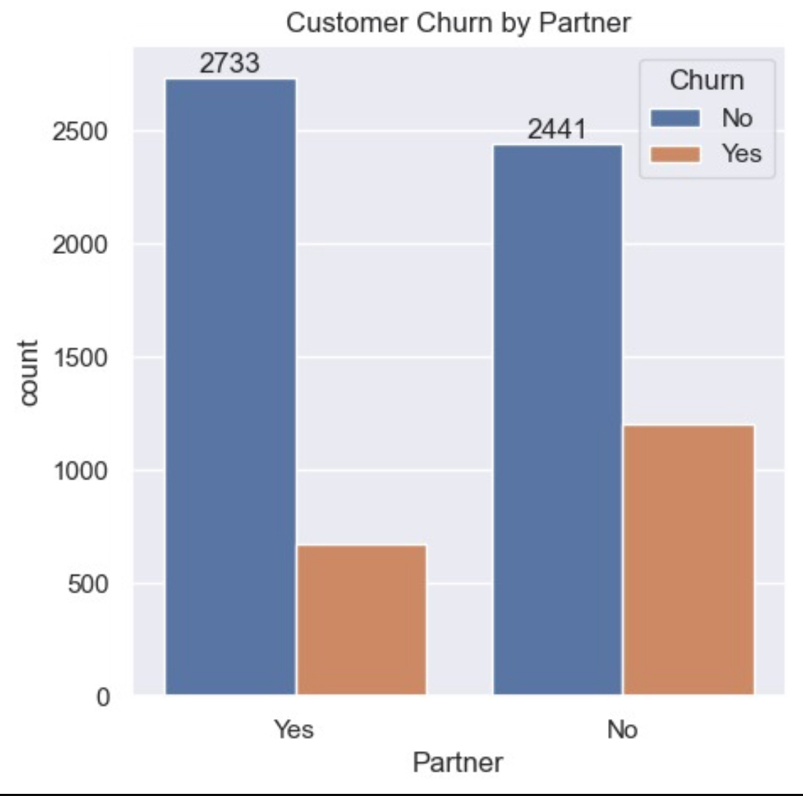
Online security and partner`

Slide 34
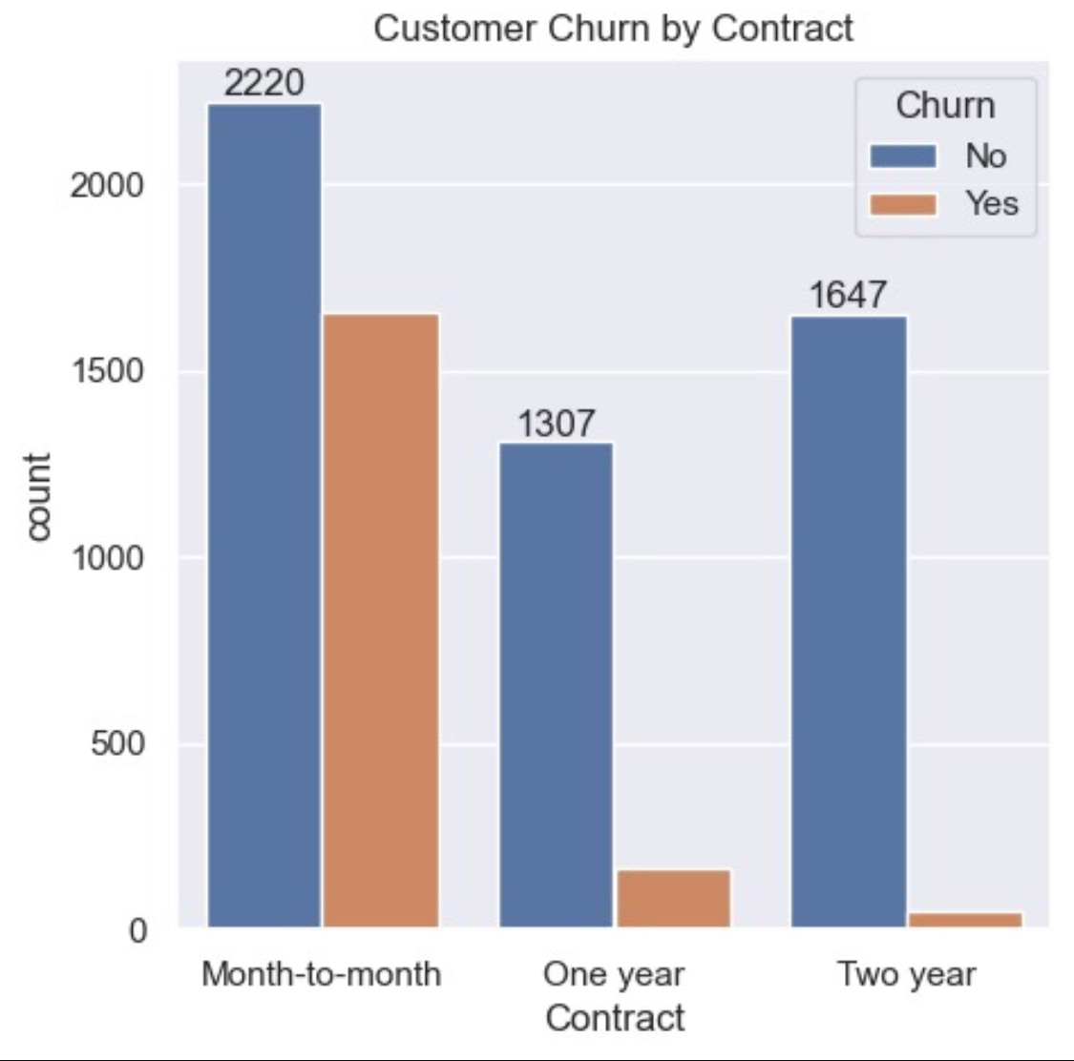
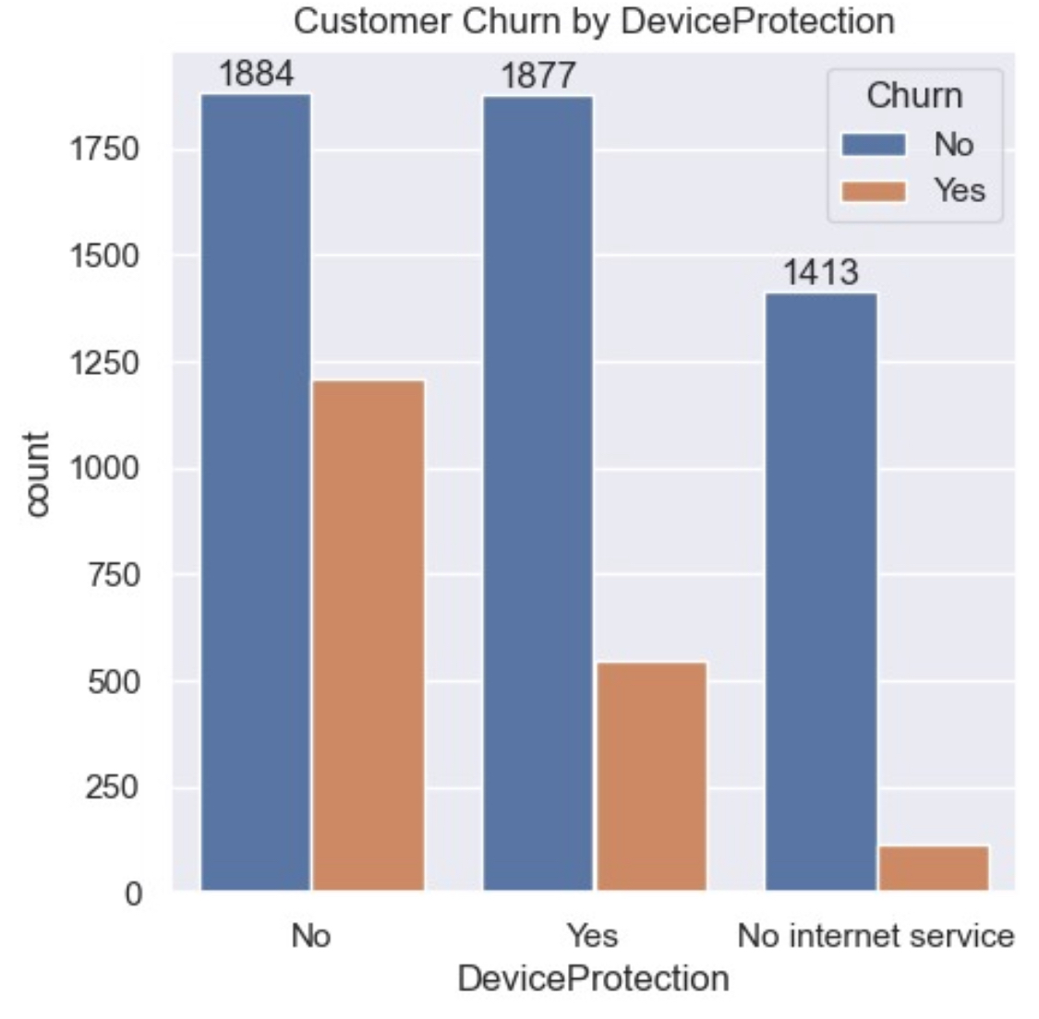
Contract and device protection

Slide 35
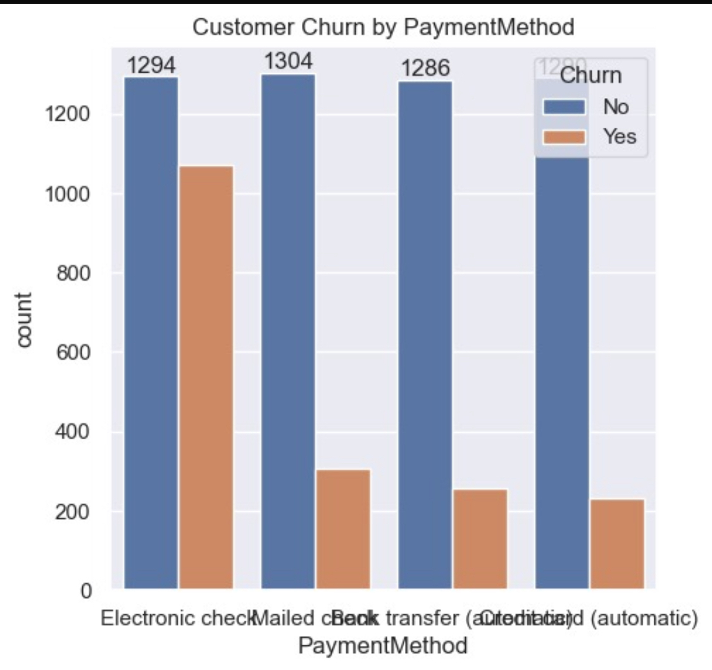
Payment method

Slide 36
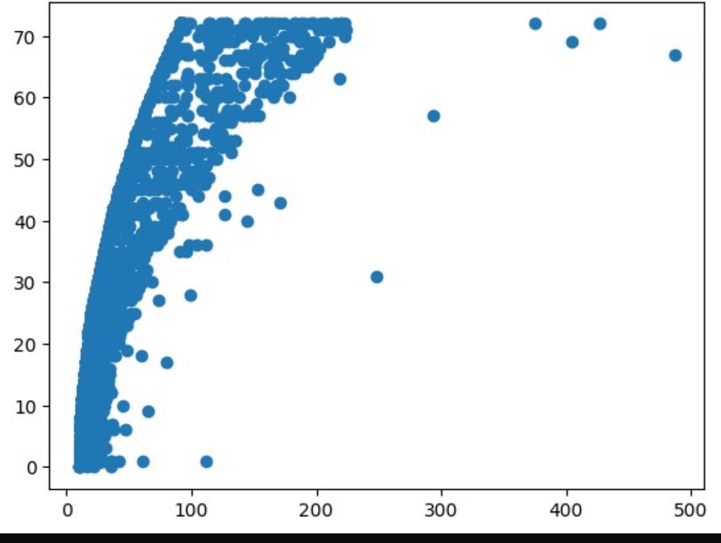
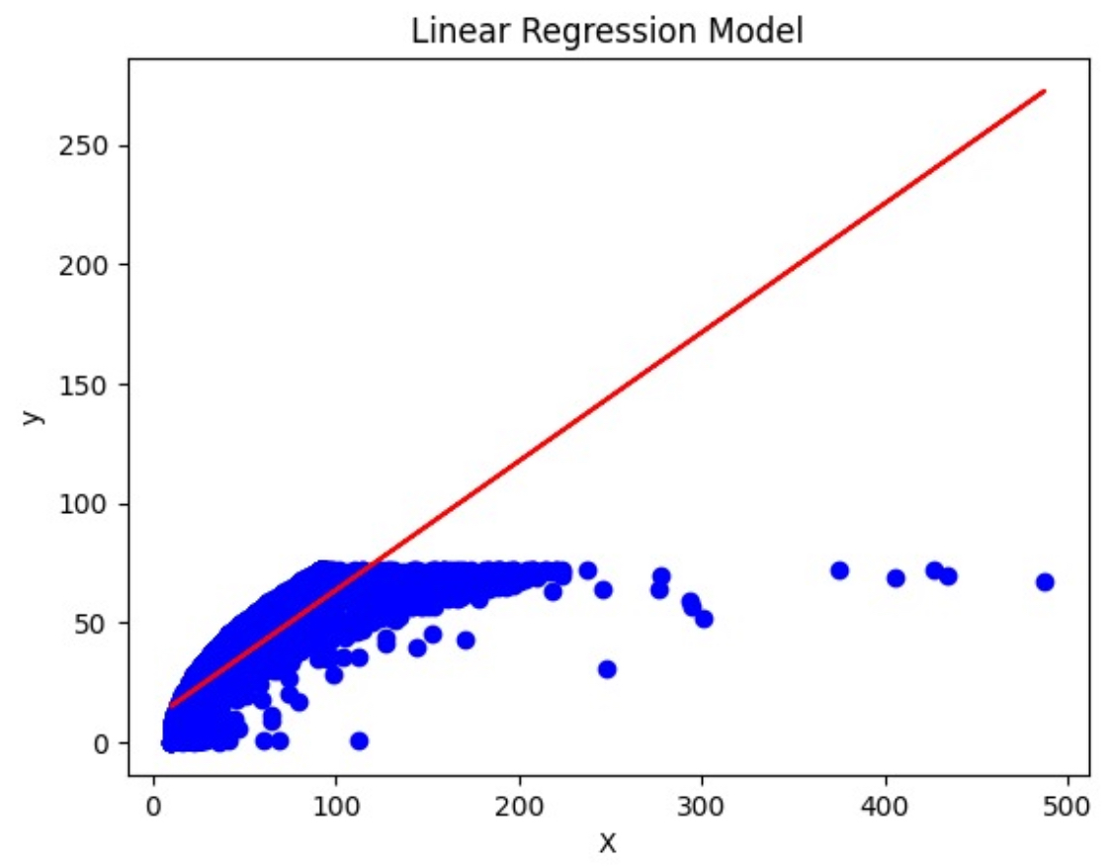
Predicting tenure based on age
accuracy:0.6387268190661232

Slide 37
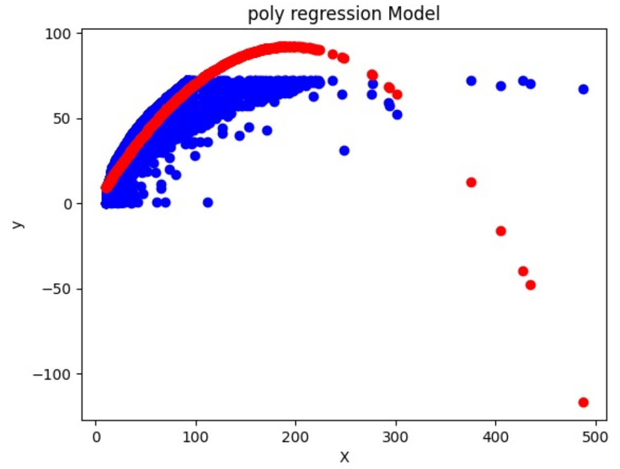
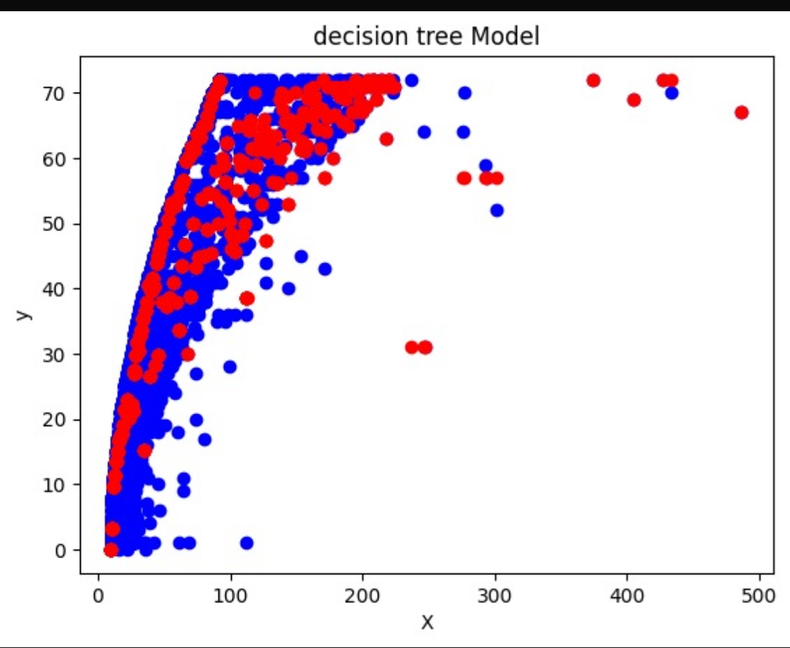
Predicting tenure based on age
accuracy: 0.8458727893403879
accuracy: 0.9266297656544139

Slide 38
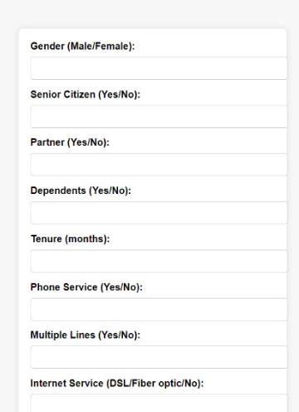
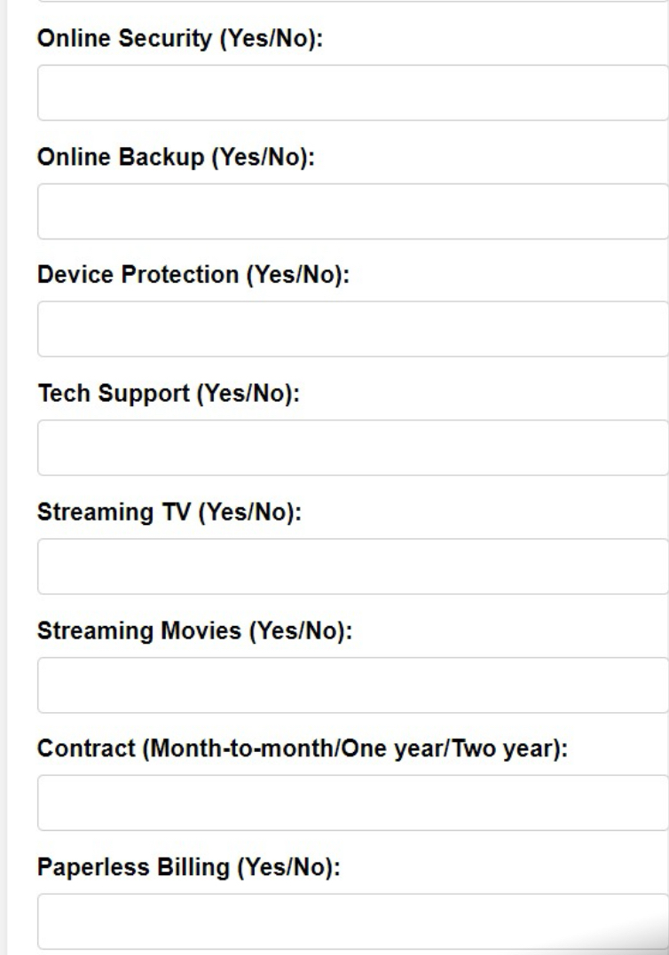
Flask app ( predict of customer churn)

Slide 39
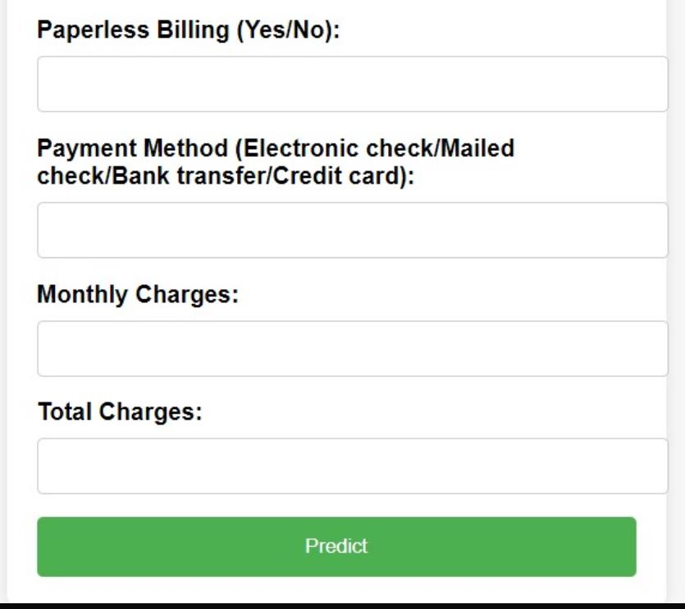
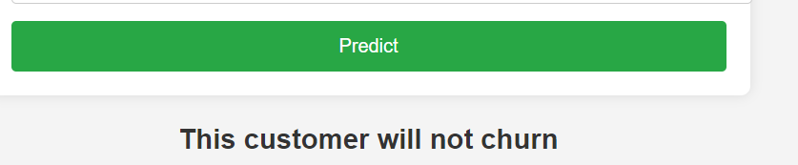
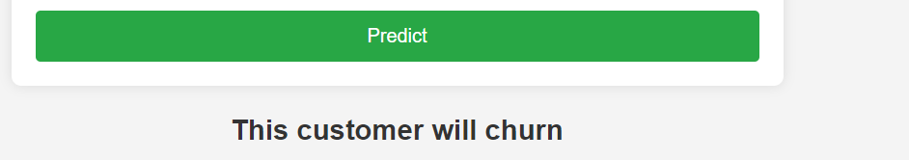
Flask app

Slide 40
Methodology of the training model
The dataset, from a telecommunications company, was loaded from a CSV file and underwent several key preprocessing steps:
• Conversion of TotalCharges to numeric: Invalid values in the TotalCharges column were converted to NaN using pd.to_numeric() and handled appropriately.
• Handling missing values: Missing values, particularly in TotalCharges, were filled with the median to avoid biasing the dataset.
• Label Encoding of categorical features: Categorical variables, such as gender and contract type, were encoded using LabelEncoder to make them usable in machine learning algorithms.

Slide 41
Methodology of the training model
After data preparation, the dataset was split into features (X) and the target variable (y), which was customer churn. An 80-20 train-test split was applied, with 80% of the data for training and 20% for testing.
• Feature scaling was done using StandardScaler to normalize the features for consistent model performance.
• A Random Forest classifier was chosen for its ability to handle tabular data and prevent overfitting. The model was trained on the training set and made binary predictions (churn or no churn) on the test set.

Slide 42
Methodology of the training model
The confusion matrix was used to assess the Random Forest model’s performance by showing correct and incorrect predictions for churn and no-churn cases:
• True Positives: Correctly predicted churn.
• True Negatives: Correctly predicted no churn.
• False Positives: Incorrectly predicted churn for customers who didn’t churn.
• False Negatives: Incorrectly predicted no churn for customers who actually churned.
The feature importance plot revealed key features influencing churn predictions:
• Tenure: Customer duration with the company.
• Monthly Charges: Monthly payment amount.
• Total Charges: Total revenue per customer. These factors heavily impacted churn likelihood.

Slide 43
Methodology of the training model
The ROC Curve was plotted to assess the model’s ability to distinguish between churners and non-churners across various thresholds. The AUC (Area Under the Curve) was calculated, with a higher AUC indicating better model performance in separating the two classes.
A churn distribution plot highlighted the class imbalance in the dataset, where most customers did not churn. This imbalance is a common issue in churn prediction.
A Monthly Charges distribution histogram showed customer spending patterns, providing insights into how monthly charges may relate to churn likelihood.

Slide 44
Methodology of the training model
Tenure Distribution
The tenure distribution revealed how long customers tend to stay subscribed. Understanding tenure helps in identifying which customers are more loyal and which are at risk of leaving.
Correlation Heatmap
A correlation heatmap was created to visualize the relationships between the variables. This helped to detect which features are correlated with each other and with the target variable (`Churn`). For example, tenure and MonthlyCharges had notable correlations with `Churn`.

Slide 45
Conclusion
Random Forest achieved significant accuracy in predicting customer churn.
Slight imbalance in predicting churned vs non-churned customers.
Future work: Consider hyperparameter tuning or different models for improvement.

Slide 46
Objective of the Analysis
The main goal is to reduce customer churn and increase customer satisfaction by improving contract conditions and customer support.
This analysis helps us better understand our customers and identify areas of improvement.

Slide 47
"City-Wise and Customer Churn Performance Overview with Revenue and Charges Analysis"
Introduction

Slide 48
Data Overview
The data analyzed includes:
Total number of customers.
Various contract types.
Customer subscription duration (Tenure).
The level of customer support received.
Visual: You can use a table or chart showing the overview of the data, such as customer count and distribution across these categories.

Slide 49
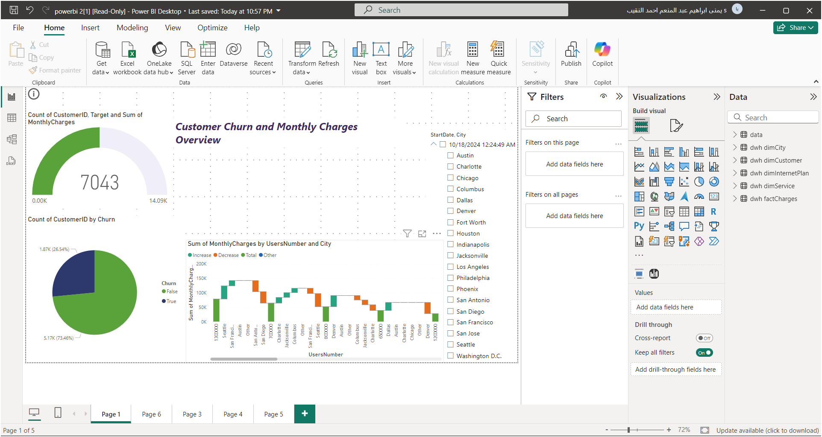

Slide 50
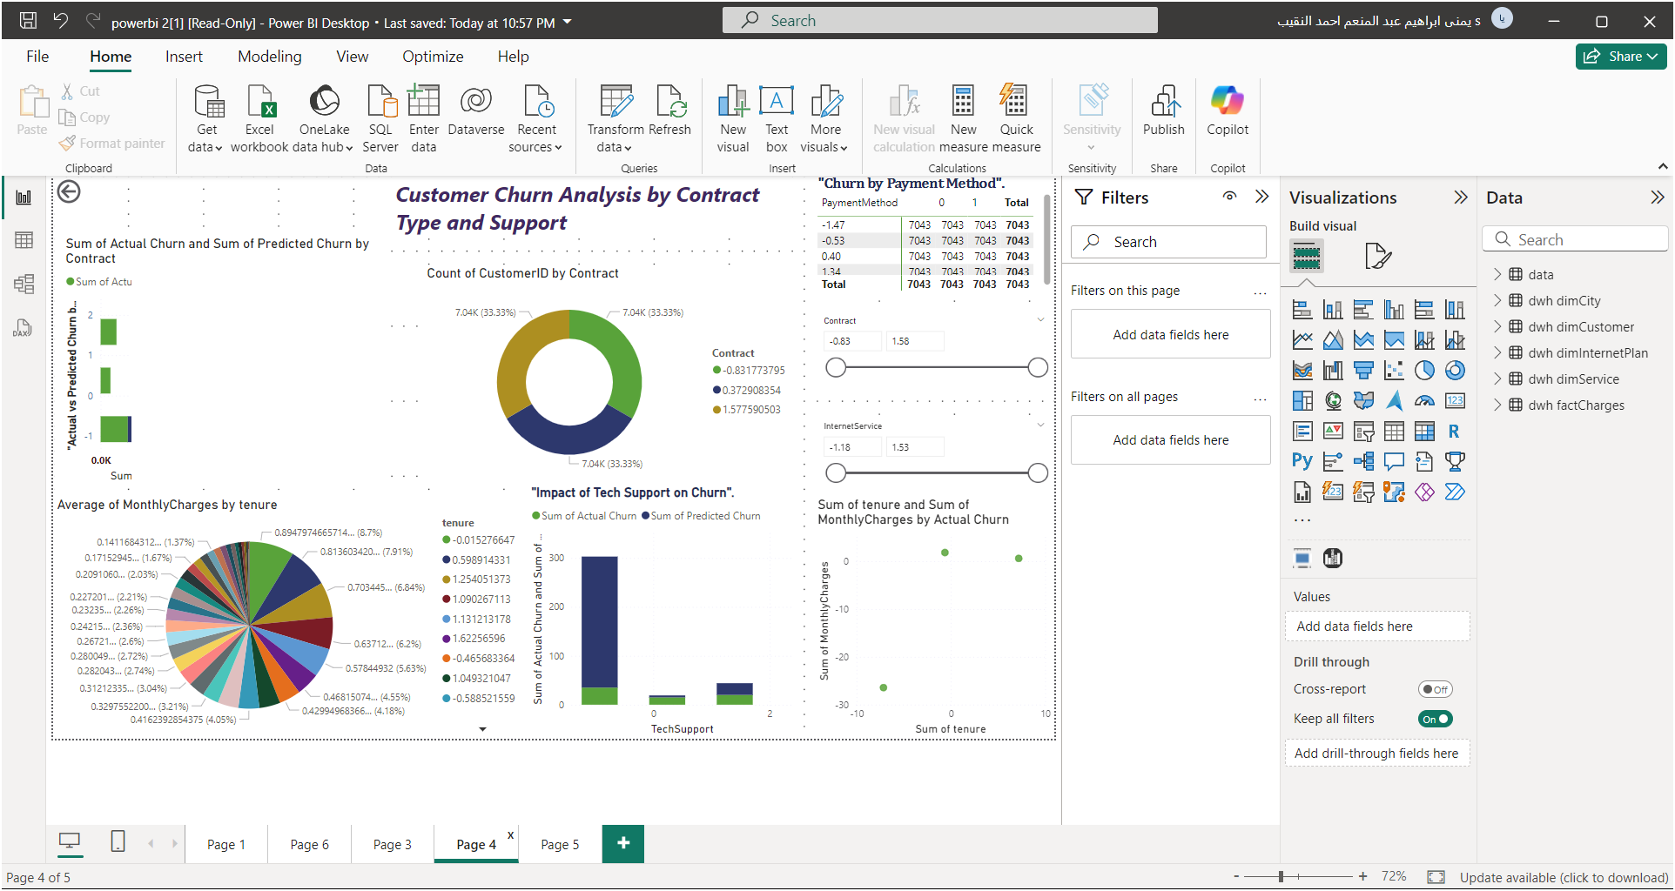
Tenure Analysis
40% of customers have been subscribed for 0-6 months.
New customers represent the largest group but are more prone to churn.
Conclusion:
New customers are at higher risk of churn.
Visual:
Insert the Pie Chart for Tenure Distribution here to illustrate the distribution of customers based on their subscription length.

Slide 51
Contracts Analysis
Slicer Explanation:
The slicer displays contract performance from -0.83 to 1.58.
Negative values = higher churn; positive values = better performance.
Focus on improving contracts in the negative range to reduce churn.
Pie Chart Explanation:
The pie chart shows the distribution of contract types (e.g., monthly, yearly).
If short-term contracts dominate and have high churn, they need improvement.
Long-term contracts likely have lower churn, indicating better customer retention.

Slide 52
Customer Support Impact
Analysis: The Influence of Customer Support on Retention
Customers who receive strong customer support are less likely to churn.
Poor support is associated with higher churn rates.
Recommendation:
Train customer support teams and improve response to customer needs.
Visual:
Use a chart that illustrates the relationship between customer support quality and churn rate (if available in your visuals).

Slide 53

City-Wise Performance Overview
Key Points to Highlight:
Analyze performance by city, focusing on area and customer count.
Highlight top-performing cities like Jacksonville and Seattle.
Connect findings to company goals: "Total Revenue Per Customer" and achieving the financial target.
Suggested Sentence:
"Analysis shows that Jacksonville and Seattle excel in area and customer count, indicating that growth strategies should target these cities. We have also achieved our financial goal at 100%."

Slide 54

Key Influencers for Customer Churn
Key Points to Highlight:
Analyze factors affecting lower customer churn rates.
Link specific internet plans to higher customer retention rates.
Use the "Key Influencers" analysis to suggest changes in internet plans to boost customer loyalty.
Suggested Sentence:
"The analysis reveals that the DSL_plan_11 is the most effective in reducing customer churn. We can enhance our loyalty strategies by promoting this plan."

Slide 55

Financial Performance and Monthly Analysis by Customers and Cities
Key Insights:
Financial Performance:
Total Charges: -23.83 (due to discounts or revenue decline).
Revenues: Stable, with a slight end-of-period increase.
Churn Rate:
Cancellations: 70.
Predicted Churn Rate: 0.21, indicating a need for action.
Contract Performance:
Negative contracts at -0.83 indicate retention challenges.
Positive contracts at 0.37 and 1.57 show better performance.
Recommendations:
Enhance Customer Experience to reduce churn, especially for short-term contracts.
Promote Well-Performing Contracts through improved marketing.
Introduce Flexible Payment Plans to attract more customers and boost revenue.

Slide 56







Team
Elsayed Essam
Hazem Ahmed
Ahmed Aboelwafa
Yomna Elnakeep
Loay Gamal
Abdelrahman Ashraf
Mohammed Gamal

Slide 57

Thank You

